Slide 1
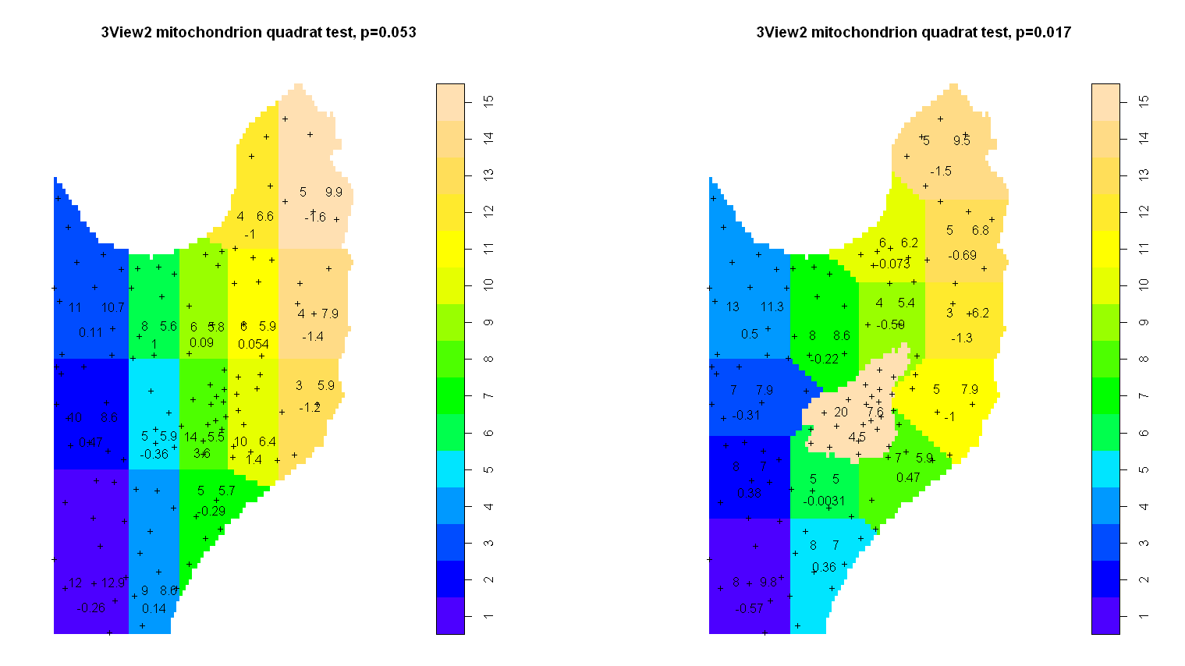
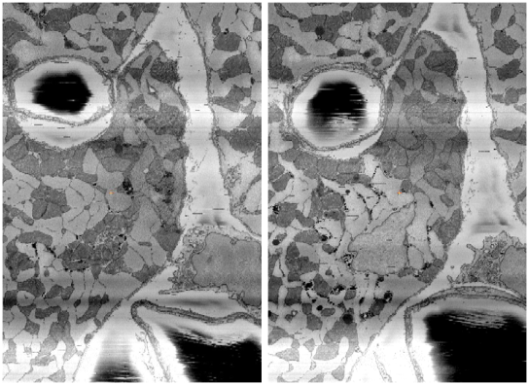
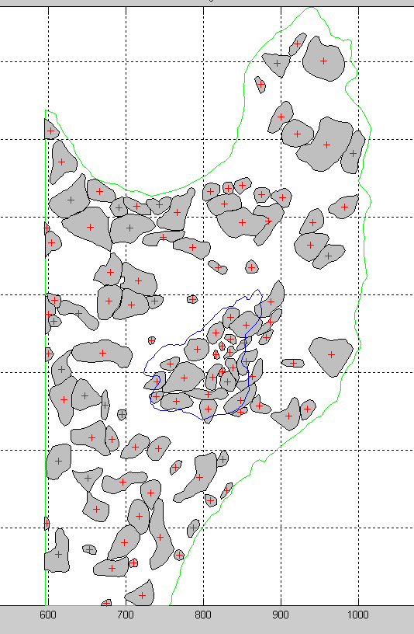
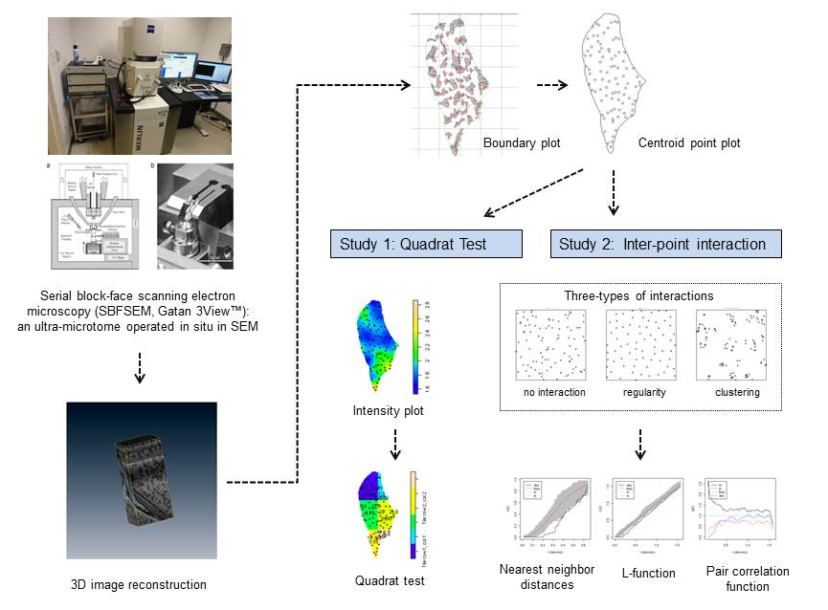
VISUALIZATION, MODELING, AND SPATIAL STATISTICS OF MITOCHONDRIAL ASSEMBLY IN ADULT CARDIOMYOCYTES USING SERIAL BLOCK-FACE SCANNING ELECTRON MICROSCOPY
Jenny Yan¹, Cameron G. Walker², Michael J. O’Sullivan², Eric A. Bushong¹, Mark H. Ellisman¹, Masahiko Hoshijima¹, Vijayaraghavan Rajagopal².
¹University of California San Diego, La Jolla, CA, USA, ²University of Auckland, Auckland, New Zealand.
INTRODUCTION
STUDY 1: Quadrat Test
STUDY 1?: Quadrat Test
STUDY 2: Inter-point Interaction
Mitochondria are recognized as dynamic organelles, which constantly undergo morphological remodeling through fusion and fission processes. However, their geometric details including individual shape, size, and spatial distribution have not been quantitatively characterized in adult cardiomyocytes. Standard optical microscopy is unable to resolve neighboring mitochondria, which are intensely packed between myofilament bundles and narrow sub-sarcolemmal space. On the other hand, 3D reconstructs generated by serial thin-section transmission electron microscopy (EM) or EM tomography can only provide a limited field of view. We approach this problem by using a novel advanced 3D electron microscopic technology, serial block-face scanning electron microscopy (SBFSEM).
A
B
We performed two trials of distribution analysis using quadrat tests. In the first trial (Fig 3A), cell anatomical features were not taken into consideration. Borderline inhomogeneity with a p-value of 0.053 was found. In the second trial (Fig 3B), to investigate the source of this inhomogeneity, the quadrat test was rerun to incorporate the location of the nucleus in the 3D stack by using the nucleus boundary (shown in Fig 2C) to define anatomy-guided quads. Following the reorganization of quads, the test indicated strong evidence against random distribution and quantitatively proved that mitochondria were clustered near the nucleus (p=0.017).
A
B
C
Figure 5: Interaction statistics. A, nearest neighbor distances; B, L-function (pair-wise distances), and C, PCF. In (A) and (B) the red line represents the theoretical curve, the black is the observed, and the gray area is the confidence band. In (c), the green represents a Poisson process, the blue is the observed, the black and red are the upper and lower envelopes (confidence band).
Figure 2. 3D surface-mesh models of mitochondria in adult mouse ventricular cardiomyoyctes generated from SBFSEM images. Part of inter-myofilament mitochondria (purple) were segmented and triangular meshes were generated with that of surface sarcolemma (light blue). The size of this cuboid image is 14 µm x 14 µm x 32 µm (pixel size: 3.5 nm x 3.5 nm, slice interval: 70 nm ). B is a high magnification view of a part of A.
A
B
The observed interaction was compared to the theoretical interaction if it were a Poisson process. Fig 5A clearly shows that the mitochondrial distribution does not fall into the homogenous poisson model. It is evident that there is indeed repulsion at low radii (under 40). Fig. 5B and 5C indicate that there is some clustering behaviour above a radius of 40.
OBJECTIVES
During segmentation of mitochondrion boundaries in cross-sectional slices generated from SBFSEM images, we noticed a distinctly large cluster of mitochondria (Fig. 3A, arrow). A further investigation found the presence of a nucleus right beneath the cluster of mitochondria seen in our original cross-section (Fig 3B). We speculated that the clustering of mitochondria may be due to the close proximity of the nucleus, so we then segmented the nucleus boundary and projected onto the original cross-section of segmented mitochondria (Fig 3C). It was evident that the cluster did in fact lie within the shadow of the nucleus.
To quantitatively characterize the spatial distribution of cellular organelles such as mitochondria in cardiomyocytes to progress toward a better understanding of the underlying mechanisms of cardiac cell function.
METHODS
Figure 4. Quadrat tests. A, original test without anatomical consideration. B, test refinement with the projection of the nuclear boundary to map quads.
CONCLUSION
Adult mouse ventricular tissues were imaged using serial block-face scanning electron microscopy (SBFSEM). Geometric models of mitochondrial organization were created. For quantification, individual mitochondrion boundaries were segmented from the cross-sectional slices obtained from SBFSEM images using the Zinc Digitiser software (http://www.cmiss.org/cmgui/zinc), and the centroid of each boundary was calculated and plotted. Spatial statistical analyses were then applied on the data using the Spatstat package in R (www.spatstat.org) to characterize the distribution of mitochondria. Two studies were performed to investigate the randomness in distribution of centroids: (1) a quadrat test, and (2) inter-point interactions.
Distribution analysis of plotted mitochondrion centroids using a quadrat test that incorporated the location of the nucleus in the 3D stack confirmed that mitochondria were clustered near the nucleus (p=0.017).
The cell-wide inter-point interaction between mitochondrion centroids calculated by the nearest- neighbour, L-function and the pair correlation function all provide evidence against the hypothesis that the distribution is random and homogeneous. The analysis indicated a hardcore repulsion at low radii (associated with the size of the organelles limiting the proximity of the centroids) and confirm the existence of clustering of mitochondria at a meso-scale level.
The study revealed the strength of the new integrated use of SBFSEM imaging and computational statistics to characterize and parameterize the spatial distribution of cellular organelles such as mitochondria that are dynamically remodeled under a physiological condition and more intensely in disease settings such as diabetic cardiomyopathy and heart failure.
STUDY 2: Inter-point Interaction
A
B
C
The inter-point interaction of mitochondrion centroids within the cross-section of the cell was also studied. We attempted to determine whether cardiac mitochondria are interactively distributed in ventricular myocytes. Three types of interactions, i.e. no interaction (homogenous/random process; the location of any one point is independent of where another lies), clustering (attraction between points), and regularity (repulsion between points) were characterized by plotting nearest neighbor distances, the L-function, and the pair correlation function (PCF).
Nearest neighbor distances: the cumulative distribution function of nearest neighbor distances indicates, on average, the number of points in the point pattern process that have a nearest neighbor within a given radius r.
L-function: while nearest neighbor distances only look at one other point, the L-function illustrates how distances between two points (pair-wise distances) change as the neighborhood size changes. For a random Poisson distribution, this change is linear. Thus, if a point process follows a Poisson process, as the neighborhood size increases, pair-wise distances should match that change and increase linearly.
PCR: the PCF is a derivative of the L-function and measures the rate of change of pair-wise distances.
Nuc
Figure 3. Mitochondria boundary determination in cross-sectional slices of a SBFSEM mouse cardiomyocyte image. Cross-section of mouse cardiac cells just above the nucleus (A) and at the nucleus (B). Arrows indicate clustered mitochondria. Nuc, nucleus. C shows auto-segmented mitochondrial boundaries generated in the image A with a projected nuclear boundary (shown in a blue line) from the image B.
Subsequently, we analyzed the spatial distribution of the mitochondrion centroids with a quadrat test, a quantitative measure of intensity (local point density). The cross-sectional cell was divided into smaller regions, and the number of points observed within each quad was compared to the number of points expected in a homogenous Poisson distribution, which assumed complete randomness. This performs a chi-squared test with a null hypothesis of complete statistical randomness (CSR).
ACKNOWLEDGEMENTS
Jenny Yan gives special thanks to Elizabeth Theakston of the University of Auckland for her guidance and support during this work. Tapaswani Das is acknowledged for her computational support. UCSD Pacific Rim Undergraduate Experiences (PRIME) made this study possible and we thank to Drs. Peter Arzberger and Gabriele Wienhausen. Jenny Yan was also supported by the Tosh Nomura & Annette Okamoto-Alexander Research Scholarship. SBFSEM imaging was supported by NIH P41 RR004050. Hoshijima was supported by AHA Established Investigator Award. Rajagopal was funded by the Royal Society of NZ.
Figure 1. The work flow of the current study.

