Slide 1
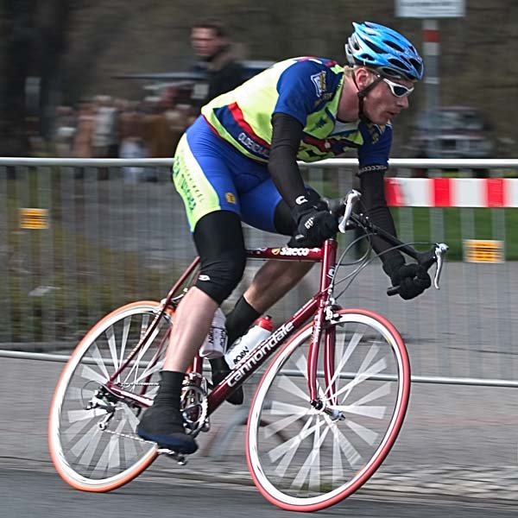
Bioenergetics
Introduction to Bioenergetics

Slide 2
Next Topics: Biology, Bioenergetics, Biomechanics
In this lecture block we will look in more detail at biological processes and understand how the biological systems use food (fuel) and convert it into useful work.
To understand the processes involved, we will cover topics including:
Cell structure and function
Energy and energy usage in the context of biological systems (Bioenergetics)
Biotechnology
Biomechanics

Slide 3
Comparison between mechanical and biological work
The aim of this exercise is to identify some key differences between the way in which man-made process use fuel to drive a mechanical movement and the way biological systems do this.
Calculate the energy required to fly from Auckland to Wellington and compare it to the energy required if cycling.
Is mechanical work more efficient than biological work?

Slide 4
Data for the calculations
Distance: 658 km
By Air:
Airbus, A320, 128 passengers
3,500 kg of jet fuel AKL-WGN
Jet Fuel; energy value = 36.8 x10⁶ J/litre; density = 0.802 kg/litre.
By Bicycle:
Average Energy required, 80 kg person:
2,000 kJ/hour cycling moderately
292 kJ/hour resting
Assume it will take 4 days and 3 nights to cycle, cycling for 8 hours during each day.

Slide 5
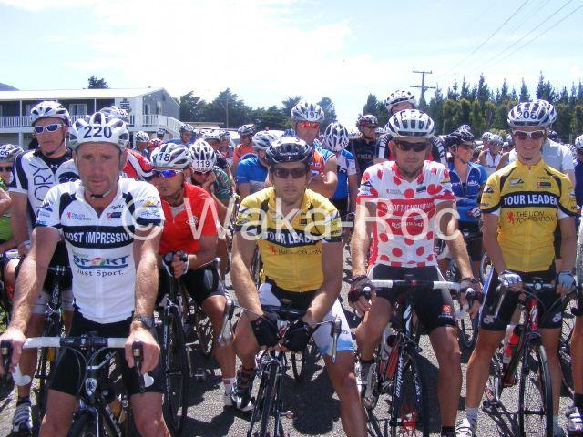
Beyond the call of duty

Slide 6
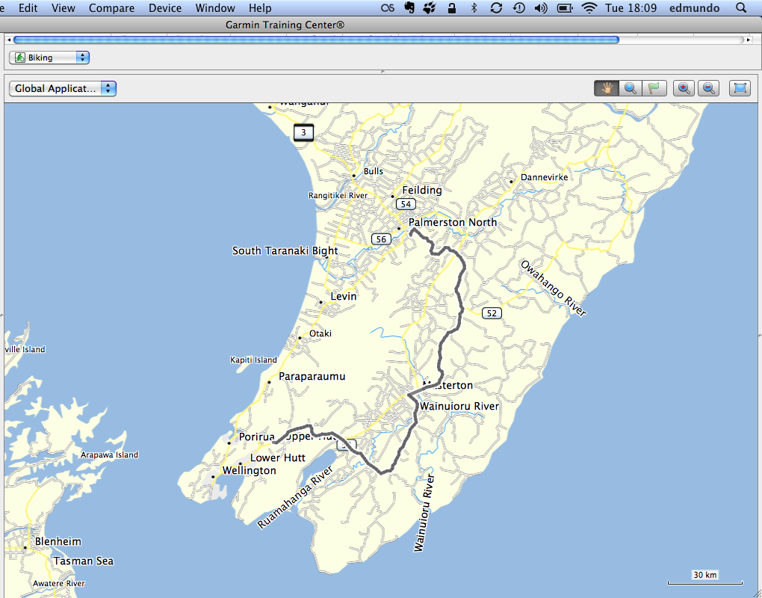
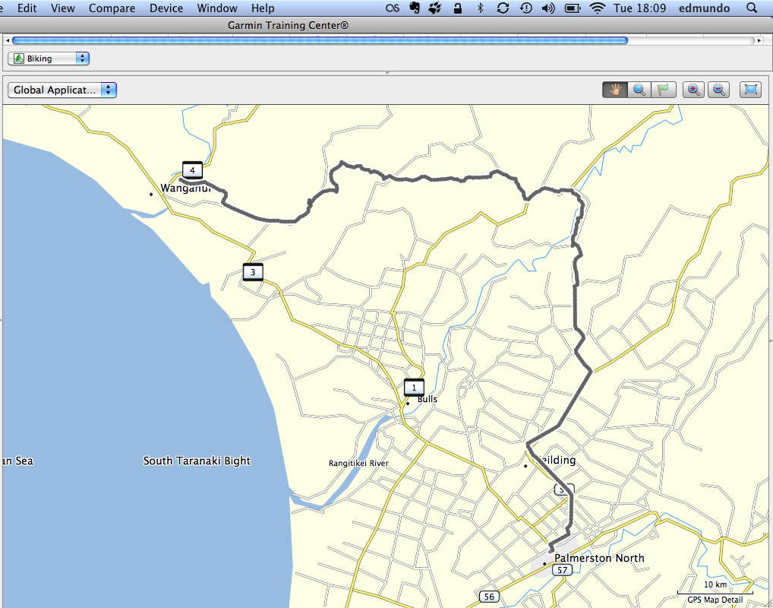
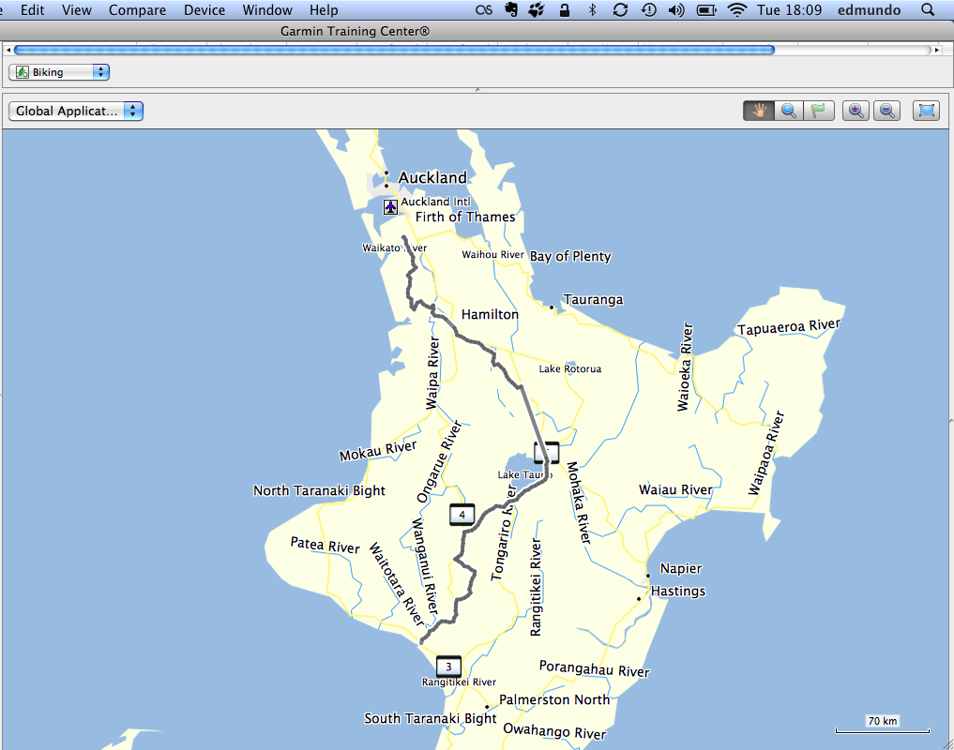
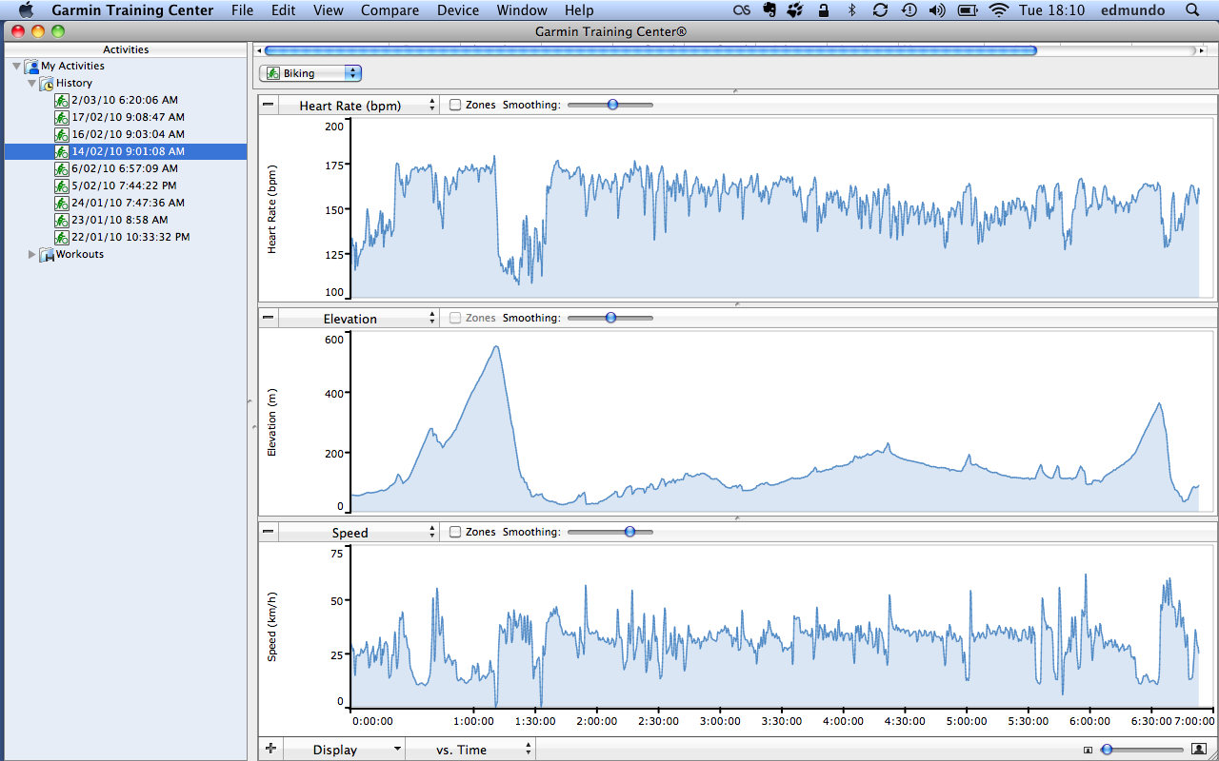
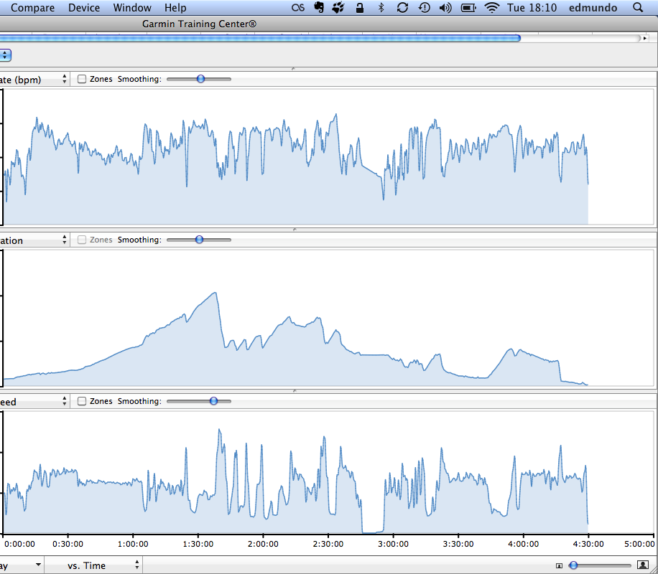
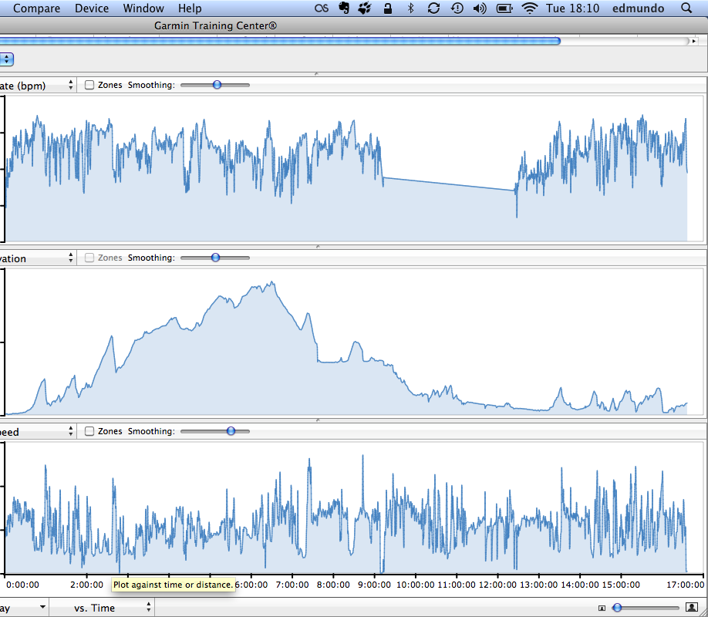
Garmin
Rimutaka hill
28 hrs cycling

Slide 7
Data for the calculations
Distance: 658 km
By Air:
Airbus, A320, 128 passengers
3,500 kg of jet fuel AKL-WGN
Jet Fuel; energy value = 36.8 x10⁶ J/litre; density = 0.802 kg/litre.
By Bicycle:
Average Energy required, 80 kg person:
2,000 kJ/hour cycling
292 kJ/hour resting
Assume it will take 7 days, cycling for 4 hours each day.

Slide 8
Calculation of energy to fly (mechanical)

Slide 9
Calculation of energy to cycle (biological)

Slide 10
Comparison between flying and cycling
Flying
Fast
Less efficient conversion of chemical energy into work
High Temperatures
Uncontrolled combustion reactions
Cycling
Slow
More efficient conversion of chemical energy into work
Low Temperatures
Controlled series of complex reactions to convert glucose into CO₂ and H₂0

Slide 11
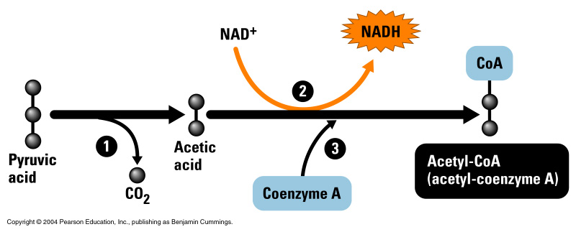
1.
2.
3.
Net Reaction:
C₆H₁₂O₆ + 6 O₂ → 6 CO₂ + 6H₂O

Slide 12
Handout: Intro to Biological Molecules
In order to understand the workings of cells and therefore living things, a knowledge of the molecules found in cells will be useful.
The four main categories of biological molecules are:
Carbohydrates
Lipids
Proteins
Nucleic Acids
A handout with information on each of these types of molecules is available on CECIL.

Slide 13
Unifying principles of biology
Biological organisms are made up of cells
Biological organisms obey the laws of physics and chemistry
Biological organisms require energy for life, and are able to convert energy from one form to another.

Slide 14
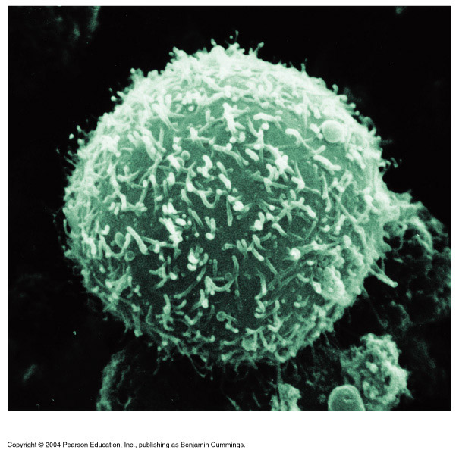
Introduction to cells
CELLS ARE THE FUNDAMENTAL FUNCTIONING UNITS OF ALL LIVING THINGS.
EVERY SINGLE THING THAT YOU DO IS DUE TO PROCESSES OCCURRING AT THE CELLULAR LEVEL.
As humans we are made up of trillions of cells with different specialised roles within the body. The white blood cell on this slide is part of your immune system - in contrast to muscle cells which move your limbs.
Some organisms, such as bacteria, function as just one cell.

Slide 15
Seeing cells
The invention of MICROSCOPES was essential to providing an understanding of cells.
1665: First cell described by Robert Hooke when examining cork under a microscope.
1800’s: All organisms under the microscope had cells = CELL THEORY (all living things are made up of cells).
1950’s: Electron Microscopes reveal the parts of cells.

Slide 16
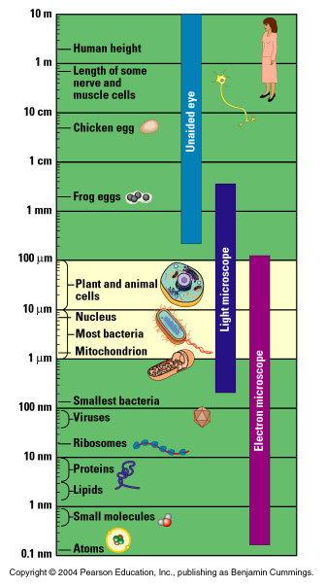
The size of cells
The logarithmic scale to the left of the diagram places the following biological structures according to size:
Bacteria
Molecules
Plant & animal cells
Viruses
Some nerve cells
Atoms

Slide 17
The two types of cells
All the cells that are found in all the organisms on Earth can be placed in one of two categories:
PROKARYOTIC CELLS
Bacteria
EUKARYOTIC CELLS
Plants
Animals
Fungi
Protists (everything else!)

Slide 18
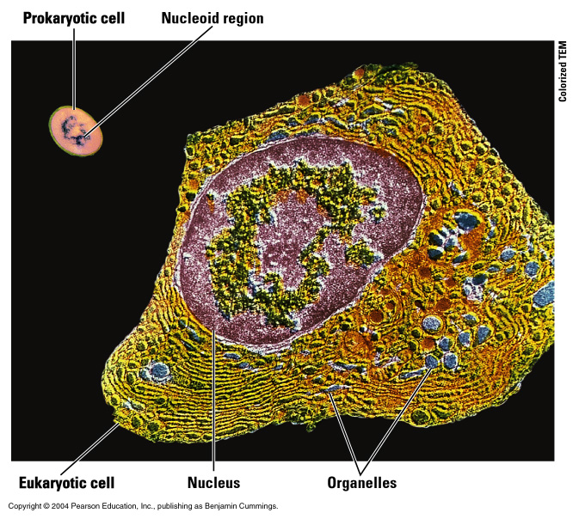
Contrasting prokaryotic and eukaryotic cells

Slide 19
Eukaryotic cells – plant and animal cells
We will focus on general animal (and plant) cells and become familiar with the major parts of these cells and their functions.
Both plant and animal cells have a thin outer layer called the PLASMA MEMBRANE.
(Plant cells also have a thicker CELL WALL)
Eukaryotic cells have an obvious NUCLEUS that contains the cell’s genetic material (DNA).
The region between the nucleus and plasma membrane is called the CYTOPLASM and is made up of a fluid called CYTOSOL. The parts of cell called ORGANELLES are found suspended in the cytosol.

Slide 20
The plasma membrane
GENERAL FUNCTION:
The plasma membrane separates the living cell from its non-living environment.
Even though the membrane is only 7 to 9 nm thick, it controls the passage of chemicals into and out of the cell.
GENERAL STRUCTURE:
The plasma membrane and other membranes are made up of mostly lipids (fats) and proteins. The lipids have a phosphate group attached and are therefore called phospholipids.
The phospholipids form a double layer called the PHOSPHOLIPID BILAYER.

Slide 21
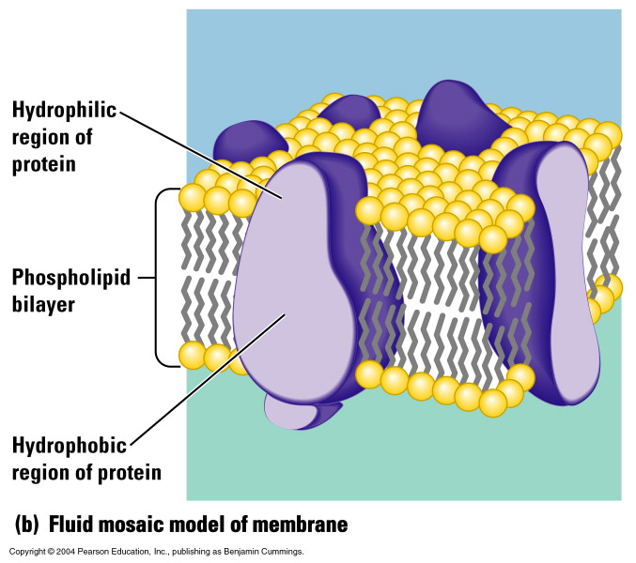
The phospholipid bilayer
Outside Cell
Cytoplasm (Inside Cell)
The phospholipids and proteins are free to drift within the membrane: “fluid mosaic model”

Slide 22
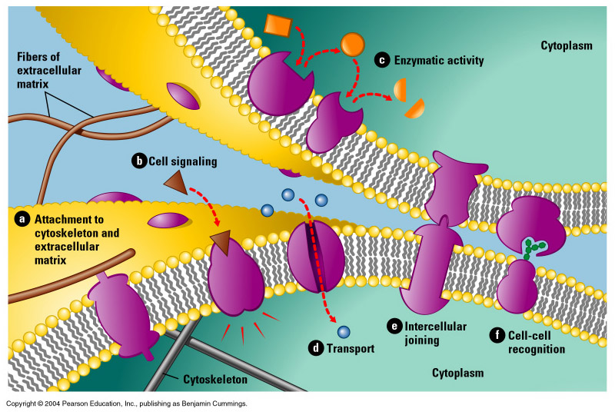
Functions of membrane proteins

Slide 23
Permeability of membrane
Plasma membranes are selectively permeable. This means that some substances can pass into and out of the cell easily while the passage of other substances is blocked.
For example:
Oxygen can pass freely into the cell and carbon dioxide out of the cell through the membrane.
Glucose can only be transported into the cell using a transport protein.

Slide 24
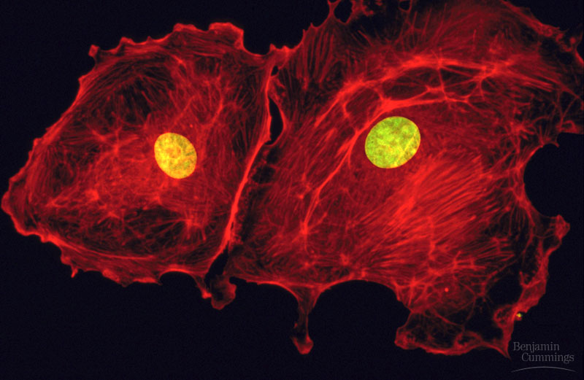
The Nucleus
The nucleus contains DNA which provides the code to make proteins.
Proteins do most of the work of the cell.
(This will be gone into in greater detail in subsequent lectures.)
STRUCTURE AND FUNCTION:
Nuclear envelope – double membrane enclosing nucleus
Chromatin – long DNA molecules plus proteins
Ribosomes – small dots for making proteins

Slide 25
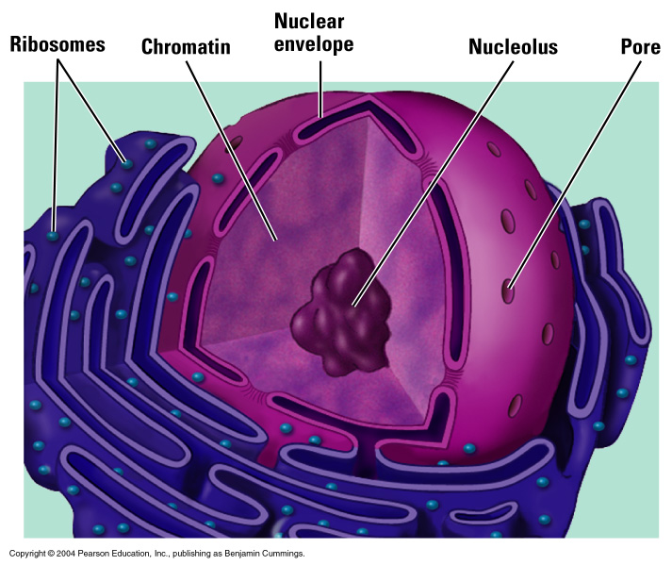
The Nucleus

Slide 26
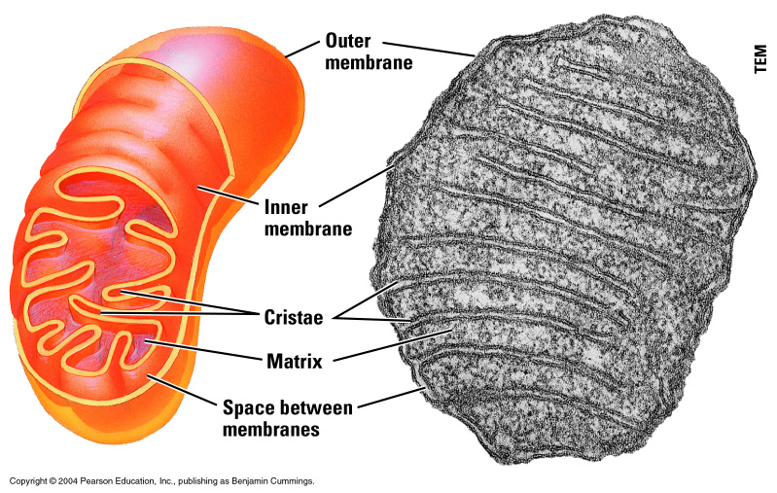
Mitochondria
MITOCHONDRIA are the organelles in which food is converted into chemical energy. This process, called RESPIRATION will be covered in detail in later lectures.
The higher the energy requirements of a cell, the more mitochondria – a heart muscle cell has many large mitochondria.

Slide 27
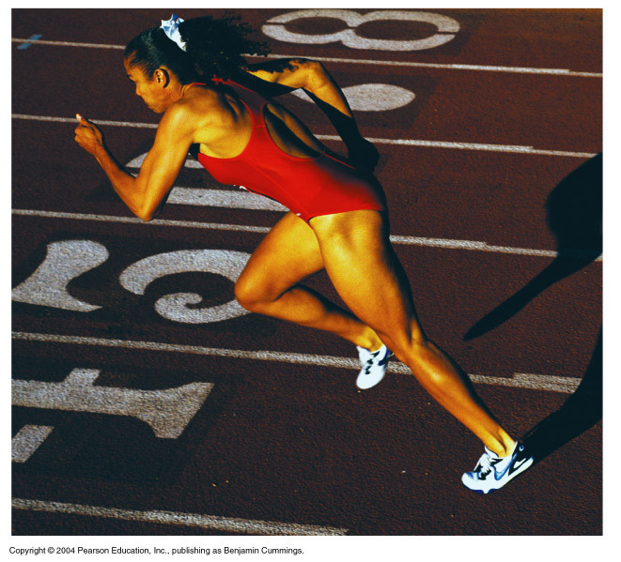
Bioenergetics
The Working Cell
Introduction to Bioenergetics

Slide 28
Eukaryotic cells
Plasma Membrane
Cytoplasm

Slide 29
Introduction to the Working Cell
We are familiar with the various parts or ORGANELLES of the cell. We now need to cover some of the processes that occur within cells that are necessary for life.
Two general processes will be covered in the next two lectures:
The energy driving cellular work
Enzyme activity

Slide 30
Energy
Energy is required to make a cell work just as it is required for the working of a car.
DEFINITION: Energy can be defined as the capacity to do work. Work has occurred when an object has been moved against an opposing force.
CONSERVATION OF ENERGY: It is not possible to create or destroy energy; energy can only be converted from one form to another.

Slide 31
Conversions of Energy
HEAT
HEAT

Slide 32
Chemical Energy
Question: Where does a working cell get its energy?
Answer: The energy-rich structures of carbohydrates and fats provide energy to cells in the form of CHEMICAL ENERGY.
Question: What is the process called whereby cells harvest this chemical energy from food molecules?
Answer: CELLULAR RESPIRATION in the MITOCHONDRIA of cells is the process whereby food molecules are broken down to release energy.

Slide 33
Mitochondria
MITOCHONDRIA are the organelles in which food is converted into chemical energy in a process called RESPIRATION.
.

Slide 34
Food Energy
Energy Content (kJ)
1500
1275
1090
757
700
605
525
502
234
184
130
Energy (kJ) consumed per hour
by a 70kg person*
3620
2505
2240
2150
845
711
660
305
255
117

Slide 35
Example
Estimate how high a ladder could a 70kg person climb fuelled by a Cadbury Moro bar.
assume muscle is 24% efficient
nutritional content of a 65g moro bar is:
10g fat, 45g sugar, 3g protein
energy content of
Fat: 39 kJ/g
Glucose: 16 kJ/g
Protein: 18 kJ/g
you can assume acceleration due to gravity is 9.8m/s²

Slide 36
Example, cont’d
Calculation:
Energy in moro bar:
10g x 39kJ/g + 45g x 16kJ/g + 3 x 18kJ/g = 1164 kJ
Energy required to climb 1 metre:
Force = 70kg x 9.8m/s² = 686N
Work done to climb 1m = 686 x 1 = 686J
Energy expended at 24% efficiency = 686/0.24 = 2860J
Total 1m climbs possible:
1164 kJ / 2.86 kJ = 407m

Slide 37
Cellular Respiration
Heat Energy
Heat Energy
Cellular Work
About 40% of the chemical energy harnessed from food molecules is used for cellular work and the rest generates body heat. Cellular respiration will be covered in detail in subsequent lectures.

Slide 38
Thermodynamics of Biological Systems
Biological systems exchange heat and matter with their surroundings
open systems
Biological systems operate under conditions of
constant temperature (37°C)
constant pressure (1 atm)

Slide 39
Thermodynamics of Biological Systems
Under what conditions does a biochemical reaction occur spontaneously?
Reminder: Enthalpy change ΔH is the maximum amount of thermal energy that can be released for the reaction at constant pressure
Does ΔH tell us if a reaction will go?
Reminder: ΔU = U_{final} – U_{initial} = q + w
ΔH < 0: exothermic reactions release heat
ΔH > 0: endothermic reactions absorb heat
But some endothermic reactions are spontaneous, so ΔH is not sufficient to determine whether a reaction will go.

Slide 40
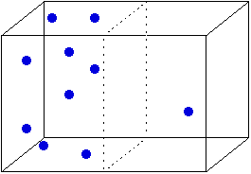
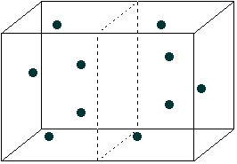
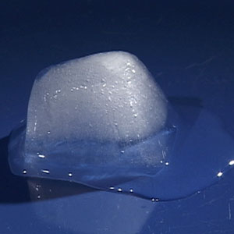
Thermodynamics of Biological Systems
Consider a gas released into a vacuum:
the gas spontaneously expands into the volume, while the total energy is unchanged
but the disorder of the system increases
Consider a block of ice melting at room temperature:
A spontaneous, but endothermic process (heat is removed from surrounding air)
liquid water is more disordered than solid ice
‘Entropy’ is a measure of how disordered a system is

Slide 41
Gibbs Free Energy
For processes occurring at constant temperature T and pressure, we combine the Enthalpy change ΔH and the Entropy change ΔS in the Gibbs Free Energy change
ΔG = ΔH – TΔS
ΔG ≤ 0 for a spontaneously occurring reaction at constant temperature and pressure
Gibbs Free Energy is the ‘potential energy’ for biochemical reactions
Reactions with ΔG ≤ 0 (‘exergonic’) occur spontaneously
Reactions with ΔG > 0 (‘endergonic’) must be driven by input of free energy

Slide 42
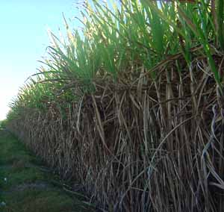
Gibbs Free Energy
Some biologically important reactions are exergonic:
e.g. combustion of glucose
C₆H₁₂O₆ + 6O₂ → 6CO₂ + 6H₂O
ΔH = −2808 kJ/mol
ΔG = −2862 kJ/mol
i.e. increase in entropy provides 54 kJ/mol free energy
Some are endergonic:
e.g. two simple (monosaccharide) sugars are combined in the sugar cane plant to produce a disaccharide sugar
glucose + fructose → sucrose + H₂O
ΔG = +23 kJ/mol

Slide 43
ATP – The Energy Currency
Endergonic reactions must have energy supplied in order for them to take place.
The chemical energy stored in the structures of carbohydrate and fat molecules must be released to supply working cells. Carbohydrates and fats can not directly supply energy to the cell.
The process of cellular respiration breaks down these molecules releasing their energy by making the energy carrier ATP.
ATP (adenosine triphosphate) molecules directly provide the working cell with energy.

Slide 44
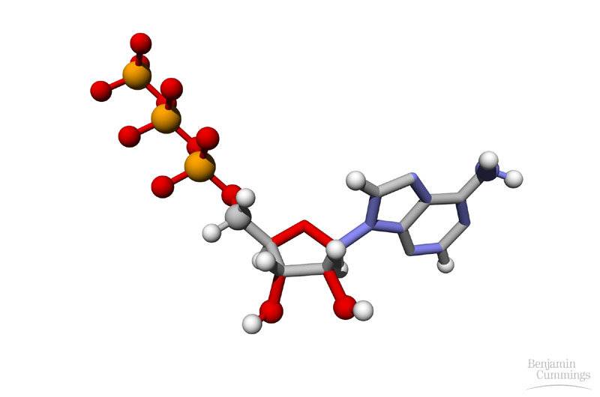
ATP – The Energy Currency
STRUCTURE:
ATP consists of the organic compound adenosine with three phosphate groups attached.
ADENOSINE P P P
The phosphate groups are the energy supplying part of the molecule. When a phosphate group is released the free energy can be used to drive endergonic reactions.
This leaves behind ADP or adenosine diphosphate.
ADENOSINE P P

Slide 45
Coupled Reactions
The splitting (hydrolysis) of ATP is exergonic
ATP + H₂O → ADP + phosphate
ΔG = −29 kJ/mol
Cells power reactions with ΔG > 0 by coupling them to the hydrolysis of ATP
e.g. in the sugar cane plant, the overall reaction in which two monosaccharides are combined to form the disaccharide sucrose is
glucose + fructose → sucrose + H₂O
ΔG = +23 kJ/mol
The free energy change for coupled reactions is found by adding the free energy change for the individual reactions
glucose + fructose + 2 ATP → sucrose + 2 ADP + 2 phosphate
+ 2×(−29 kJ/mol)
= −35 kJ/mol
We will now look at the molecule ATP in more detail

Slide 46
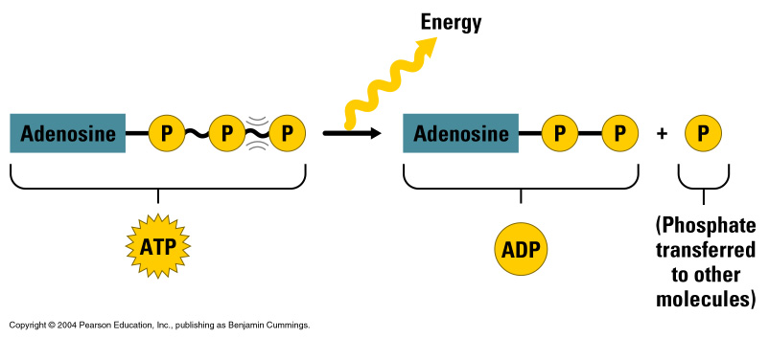
ATP and ADP
When ATP energises other molecules in a cell the phosphate group is transferred to those molecules.
The phosphate transfer assists the cell in three main types of work:
Mechanical work
Transport Work
Chemical Work

Slide 47
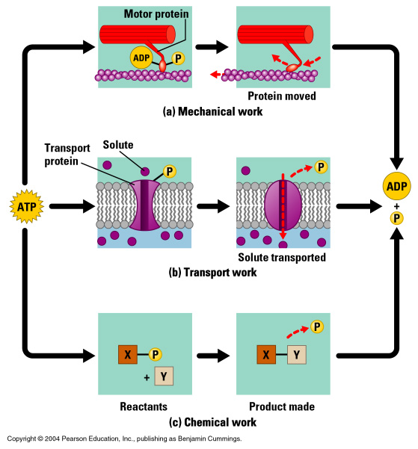
ATP Driving Cellular Work

Slide 48
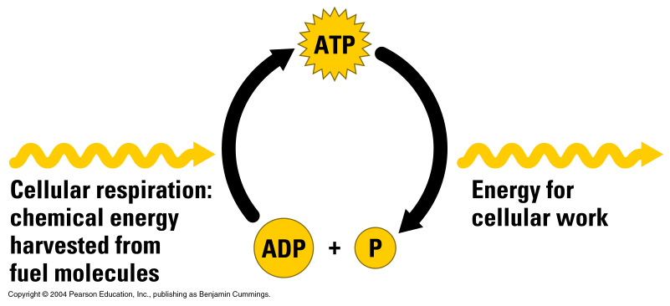
The ATP Cycle
Cells are constantly using ATP.
Cellular respiration is constantly making new supplies of ATP to be used during cellular work.
The ATP Cycle:
A working muscle cell consumes and regenerates about 10 million ATP molecules every second.
The average human recycles 100-150 moles of ATP daily, which is around 50-75 kg!
Notes:
The total quantity of ATP in the human body is about 0.1 mole. The majority of ATP is not usually synthesised de novo, but is generated from ADP by the aforementioned processes. Thus, at any given time, the total amount of ATP + ADP remains fairly constant.
The energy used by human cells requires the hydrolysis of 100 to 150 moles of ATP daily which is around 50 to 75 kg. Typically, a human will use up their body weight of ATP over the course of the day.[18] This means that each ATP molecule is recycled 1000 to 1500 times during a single day (100 / 0.1 = 1000). ATP cannot be stored, hence its consumption being followed closely by its synthesis.

Slide 49
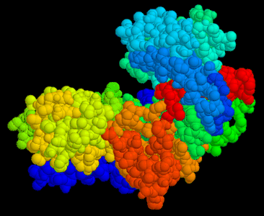
Bioenergetics
The Working Cell
Enzyme Kinetics
Notes:
Hexokinase, from http://www.biologie.uni-hamburg.de/b-online/e18/18d.htm

Slide 50
Overview
In the previous lecture we discussed the thermodynamics of biochemical reactions. Thermodynamics can be used to show whether a reaction occurs spontaneously. However, it does not tell us how fast it occurs.
The field that investigates the rates of reactions is called chemical kinetics. In this lecture we will consider factors which affect the rate of a reaction, and how cells increase the rate of cellular reactions.
In contrast to many man-made processes, in particular combustion processes, biochemical reactions are typically:
slow
energetically efficient
highly controlled – Enzyme Catalysis

Slide 51
Rate of Reaction
The rate of a reaction is the speed at which the product of the reaction is formed
amount of product formed Δn/V mol/L
Rate =
=
( )
time for the reaction to occur Δt s
10⁻⁴
10⁻³
10⁻²
0.1
1
10
~
Human at rest
Cellular rxn
Wastewater treatment
Coal furnaces
Human working hard
~
10³
10⁴
~
~
Rates of reactions (mol/m³s)
Jet engines
Rocket engines

Slide 52
Learning check
What is the rate of consumption of hydrogen gas in the following reaction when its concentration decreases by 0.2 mol/L in 10 s?
H₂ + I₂ 2 HI
Ans: Rate of consumption of hydrogen gas
= (0.2mol/L) ÷ 10s = 0.02 mol H₂ /(L*s) = 0.02 M/s
Is the rate the same if expressed in terms of HI?
Ans: Rate of production of HI = 2* Rate of consumption of hydrogen gas = 0.04 mol HI /(L*s) = 0.04 M/s
hydrogen
iodine
hydrogen iodide (acid)

Slide 53
Learning check
The average rate of combustion of a candle made of paraffin, C₂₅H₅₂ , is 8.33 x10⁻⁴ mol/min. You want the candle to burn for 4h. The candle is only sold in four sizes: 25, 50, 75 or 100 g. Which one is the smallest one you could use?
Burn rate = 8.33 x10⁻⁴ mol/min
Required burn time = 4*60 = 240 min
Amount required = 8.33 x10⁻⁴ mol/min*240 min = 0.2 mol
MW = 12.01*25+1.008*52 = 352.6 g/mol
Weight required = 352.6 g/mol*0.2 mol = 70.5g

Slide 54
Effect of temperature
The reaction rate nearly always increases with temperature. A good rule of thumb is that the reaction rate doubles with every 10°C temperature increase.
Why is the temperature important?
For a chemical reaction to occur, the molecules need to collide. However, a reaction only occurs when the collisions between the molecules have sufficient energy to break the bonds in the reactants. This energy barrier is called the activation energy E_{a}.
When a collision has the energy that is equal to or greater than the activation energy, a reaction can occur.
E<E_{a}
E>E_{a}
No reaction
Reaction occurs

Slide 55
Effect of temperature – collision theory
When a collision has the kinetic energy that is equal to, or greater than, the activation energy (E_{A}), a reaction can occur.
Low temperature
Fraction of molecules
Nr of molecules with kinetic energy >E_{A}
High temperature
E_{A}
Kinetic Energy
How does the graph show why reaction rate increases with temperature?
At higher temperature a greater proportion of molecules have higher kinetic energy therefore the probablity of a collision at >E_{A} is higher.

Slide 56
Biochemical kinetics
PROBLEM
Reactions within the cells of our body must occur at very fast rates to meet the body’s metabolic requirements. But body temperature is stable at 37 ºC.
Reactions can be sped up by heating, but boiling our cells is not an option. (why not?)
SOLUTION
Nearly all the reactions that occur within cells are catalysed by enzymes, specific molecules that catalyse biochemical reactions, speeding them up.

Slide 57
Effects of catalysts
Enzymes are biological catalysts.
A catalyst is a molecule that increases the rate of reaction without being consumed itself
Catalysts speed up the rate of a reaction by lowering the activation energy, i.e. a larger proportion of collisions now have enough energy to overcome the activation energy.
The enzyme itself is unchanged at the end of the reaction.

Slide 58
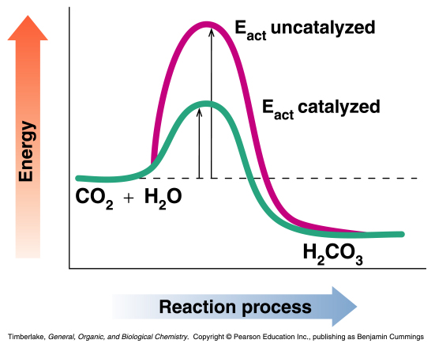
Example: carbonic anhydrase
Carbon dioxide is a waste product which must be removed from cells into the blood stream.
CO₂ disolves in water very, very slowly.
In the human body this reaction is catalysed by an enzyme called carbonic anhydrase.
This enzyme lowers the activation energy needed for the reaction between carbon dioxide and water.
One enzyme molecule can catalyse the reaction at a rate of 6×10⁵ molecules per second
This is an increase in reaction rate by a factor of 10⁷

Slide 59
Enzyme Action
Nearly all enzymes are proteins
Every enzyme has a unique three-dimensional shape that is able to bind with a small selection of reacting molecules (SUBSTRATES). This means that enzymes are very selective in terms of the reactions they catalyse.
The region on the enzyme that binds the substrate(s) is called the ACTIVE SITE. The active site has an attraction (hydrogen bonding, salt bridges, hydrophobic attractions) to the specific substrate(s). When the reaction is complete the products are quickly released so more substrate(s) can bind.

Slide 60
Enzyme Action continued
Label the following diagram of an enzyme catalysing a reaction:
The substrate(s) correctly bound to the active site is called the ENZYME- SUBTRATE COMPLEX.
To summarise, if we say substrate = S, enzyme = E, enzyme-substrate complex = ES and the product = P then ……
E + S ES E + P

Slide 61
Models of Enzyme Action
INDUCED FIT MODEL:
The active site and substrate molecule(s) slightly adjust their shape to result in a close interaction. There is exact alignment between the catalysing part of the active site and the reacting part of the substrate.

Slide 62
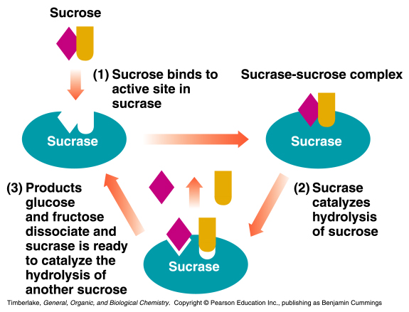
Models of Enzyme Action continued
An example: The enzyme-catalysed hydrolysis of sucrose.

Slide 63
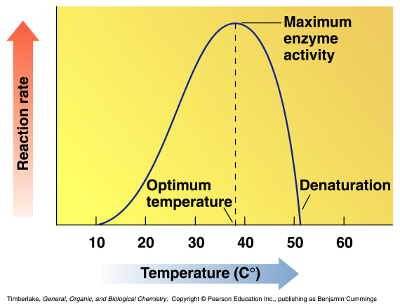
Factors Affecting Enzyme Activity
The activity of an enzyme or how fast it catalyses its reaction is affected by several factors.
TEMPERATURE: Enzymes in the human body are most active at body temperature (37 ºC). Low temperatures do not provide enough energy and high temperatures can result in the destruction or DENATURATION of enzymes.
Denaturation of proteins is why our cells cannot heat up to speed up reactions

Slide 64
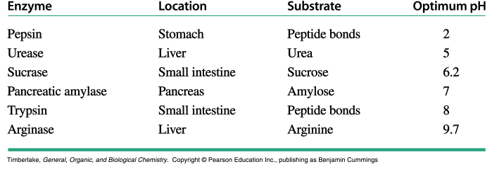
Factors Affecting Enzyme Activity continued
pH: Enzymes have an optimum pH that results in the correct three-dimensional structure of their active site. Enzymes in most cells have an optimum pH of approximately 7.4.

Slide 65
Factors Affecting Enzyme Activity continued
SUBSTRATE CONCENTRATION: As long as there is more enzyme present than substrate molecules, an increase in substrate concentration will increase enzyme activity. At some point all the enzyme active sites will be saturated with substrate and the activity will level off.
ENZYME CONCETRATION: As the enzyme concentration increases so does the rate of reaction (at constant substrate concentration).

Slide 66
Factors Affecting Enzyme Activity continued
ENZYME INHIBITION: Certain molecules called enzyme inhibitors bind to enzymes and disrupt enzyme function. These molecules can be COMPETITIVE INHIBITORS (binding to the active site) or NON-COMPETITIVE INHIBITORS (binding to another site).
Competitive Inhibition:
Non-competitive Inhibition:
Inhibitor binds to a separate site and distorts the shape of the active site.
Inhibitor prevents substrate from binding.

Slide 67
Bioenergetics
Cellular Respiration
Harvesting Chemical Energy

Slide 68
Introduction
In previous lectures have introduced cellular bioenergetics: energy is provided in the cell where it is needed to drive energetically uphill processes by the ‘energy currency’ molecule ATP
We have also looked at enzymes – biological catalysts – which cells use to speed up reactions.
In this lecture we look at the cell’s energy supply – how the cell generates ATP from fuel substrates – and how this is achieved by using a sequence of enzyme-catalysed reactions forming a metabolic pathway.
In the next lecture we will consider where the fuel molecules come from.

Slide 69
Introduction to Cellular Respiration
We now focus in detail on how the cell makes ATP, which supplies the energy for a working cell.
Recall the word and formulae equations for the process of aerobic (with oxygen) cellular respiration:
Cellular respiration is part of our metabolism (all the chemical reactions occurring in cells). The multiple arrows above show that cellular respiration is a metabolic pathway.

Slide 70
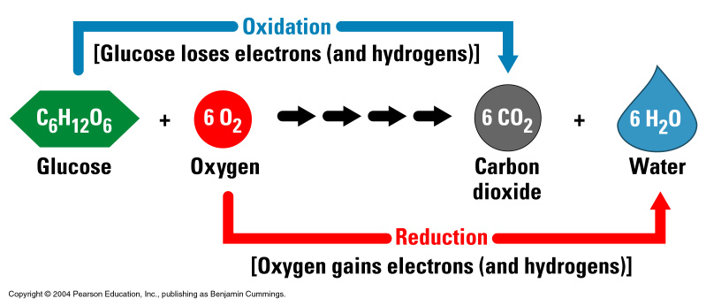
Cellular Respiration is a Redox Reaction
The process of cellular respiration involves the transfer of electrons, so can be classed as a redox reaction.
The glucose hydrogens and electrons are lost to oxygen meaning that glucose is OXIDISED.
Oxygen accepts electrons and hydrogens to form water meaning it is REDUCED.

Slide 71
The Metabolic Pathway of Cellular Respiration
The reactions in cellular respiration are be grouped into three main stages:
GLYCOLYSIS – break down of glucose started
KREBS CYCLE – break down of glucose completed and carbon dioxide formed
ELECTRON TRANSPORT – energy from break down of glucose is converted to ATP

Slide 72
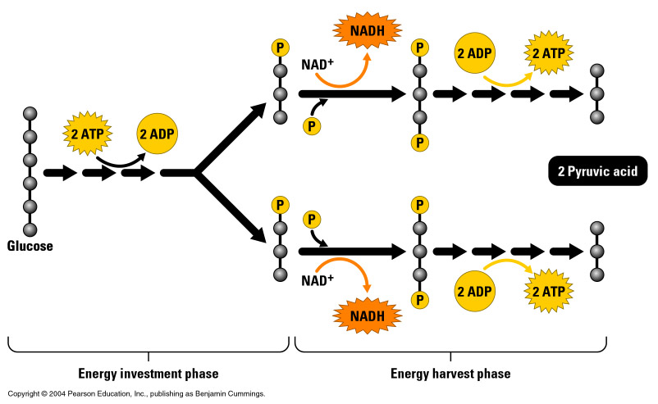
Glycolysis
The first stage, called glycolysis (splitting of glucose), occurs in the cytosol as a series of nine reactions.
As the name suggests, the six-carbon structure of glucose is split into two three-carbon molecules called PYRUVIC ACID.

Slide 73
Glycolysis continued
The reactions require an initial input of energy.
Redox reactions result in the release of hydrogen atoms and their electrons. These are picked up by NAD⁺ (energy carrier, nicotinamide adenine dinucleotide) forming NADH, to be used later in the metabolic pathway.
The final reactions in glycolysis make some ATP when enzymes transfer phosphate groups to ADP.
Input: glucose, 2 ATP, 2 NAD⁺
Output: 2 pyruvic acid, 4 ATP (2 ATP net), 2 NADH
Free energy liberated (and stored in ATP and NADH) from glycolysis: ΔG = −597 kJ/mol

Slide 74
The Krebs cycle
The Krebs cycle (or citric acid cycle) occurs in mitochondria and completes the energy extraction from glucose.
Before entering the Krebs cycle, the three-carbon pyruvic acid passes from the cytoplasm to the mitochondria and is oxidised to the two-carbon acetic acid, CH₃COOH.
Each acetic acid gets attached to the molecule Coenzyme A to make acetyl-CoA. The formation of acetyl-CoA is the link between glycolysis and the Krebs Cycle.

Slide 75
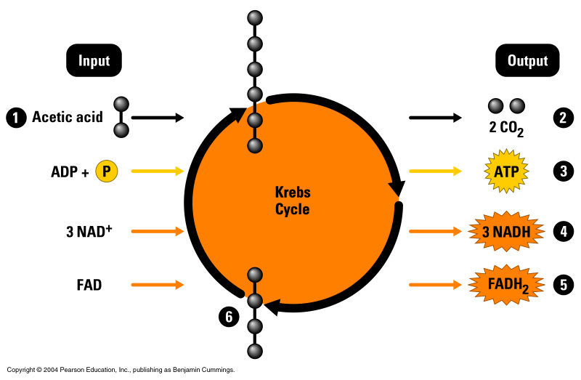
The Krebs cycle continued
Citric acid
2
4
2
2
6
6
2
2
Oxaloacetic acid
During the cycle of reactions, some of the energy released by the oxidation of C-C and C-H bonds is used to make ATP.
Most of the energy released is used to produce NADH and a second energy carrier FADH₂ (flavin adenine dinucleotide).

Slide 76
The Krebs cycle continued
per glucose molecule:
2
4
2
2
6
6
2
2
Free energy liberated (and stored in ATP, NADH and FADH₂) per acetic acid molecule: ΔG = −2265 kJ/mol

Slide 77
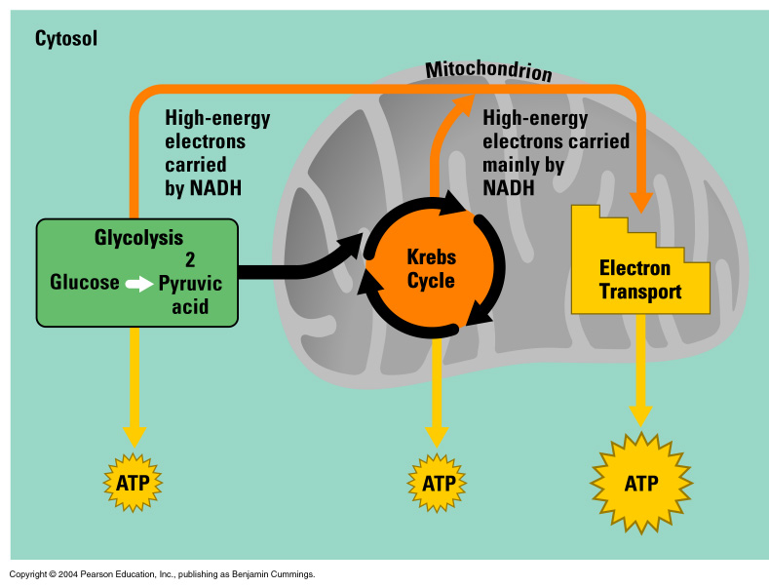
Review
We have covered the first two stages of cellular respiration – the carbon atoms of glucose are now completely oxidised and some ATP has been produced. Most of the energy, however, remains in the electrons passed to the energy carriers NAD⁺ and FAD.
The process is is completed by the ELECTRON TRANSPORT CHAIN in the inner membrane of the mitochondria.

Slide 78
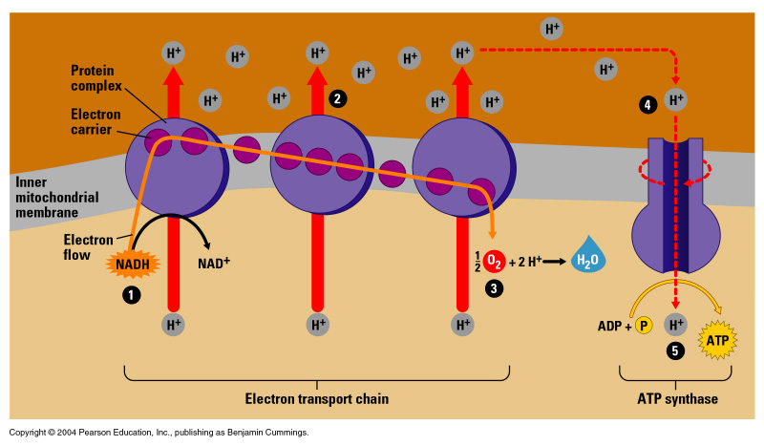
Electron transport
The high energy electrons carried in NADH and FADH₂ are passed from molecule to molecule in the electron transport chain in a series of redox reactions. The electrons give up small amounts of energy with each transfer.
The released energy is used to pump hydrogen ions across the inner mitochondrial membrane, concentrating them on the outside of the membrane.
Finally, electrons are accepted by oxygen at the end of the electron transport chain. The oxygen combines with hydrogen ions to form water.

Slide 79
Electron transport continued
Potential energy stored in the hydrogen ion gradient is released when the hydrogen ions re-enter the mitochondria through the enzyme complex called ATP SYNTHASE. ATP SYNTHASE uses the energy of the hydrogen ion gradient to generate ATP from ADP.
Input: 10 NADH, 2 FADH₂
Output: approx. 34 ATP

Slide 80
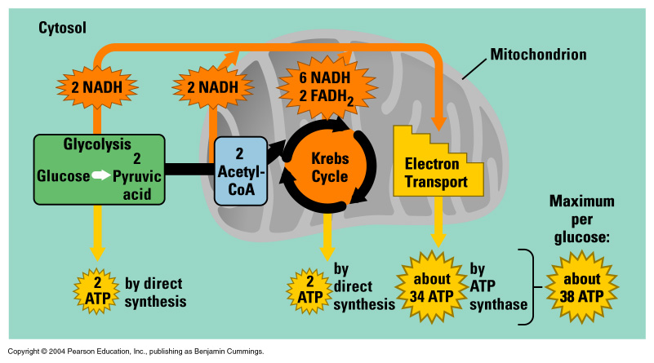
Summary of ATP production
One cell can have 1000 – 2000 mitochondria producing many energy-rich ATP molecules.

Slide 81
Cellular efficiency
Efficiency is a measure of the useful work done as a fraction of the energy input.
The engine of a motor car is 10-20% efficient
We can estimate the efficiency of the cell just as we can estimate the efficiency of an engine
The free energy available from glucose is ΔG = −2862 kJ/mol under standard conditions
In respiration 38 ATP molecules are synthesised for each glucose molecule
C₆H₁₂O₆ + 6O₂ + 38 ADP + 38 P → 6CO₂ + 6H₂O + 38 ATP
Under standard conditions, each ATP can contribute ΔG = −29 kJ/mol to drive reactions in the cell
The efficiency is 100 × (38 × 29) / 2862 = 38.5%

Slide 82
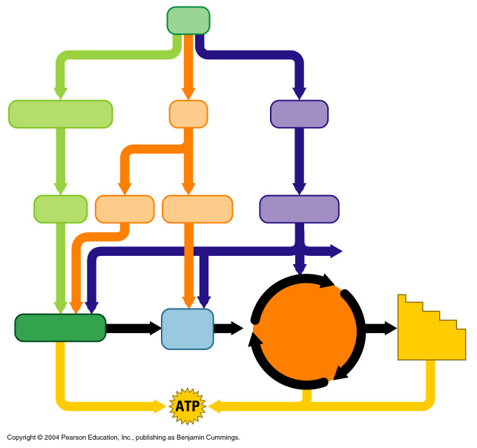
Versatility of cellular respiration
We have concentrated on the sugar glucose as the fuel broken down in cellular respiration. However, many other types of food molecules can be used as fuel.
Food
Polysaccharides
Fats
Proteins
Sugars
Glycerol
Fatty acids
Amino acids
Amino groups
Glycolysis
Acetyl-CoA
Krebs Cycle
Electron Transport

Slide 83
Fermentation: anaerobic harvest of energy
ATP can be produced under conditions that are anaerobic (without oxygen). The anaerobic harvest of food energy is called FERMENTATION.
How does this work?
Glycolysis can still occur to produce ATP as it does not require oxygen. This means that 2 ATPs can be generated for every glucose molecule.
2 ATPs versus 38 ATPs for aerobic respiration = aerobic much more efficient.
Problem: NAD⁺ accepts electrons in aerobic glycolysis to form NADH. The NADH unloads the electrons down the electron transport chain to oxygen and is recycled as NAD⁺. However, there is no oxygen present in anaerobic respiration.
Solution: NADH reduces the pyruvic acid to form lactic acid.

Slide 84
Lactic acid fermentation
Example One:
Human muscle cells – oxygen is supplied to your muscles via the blood stream for aerobic cellular respiration to take place to make ATP. However, during exercise, the supply of oxygen can be insufficient and ATP must be made anaerobically.
The build up of LACTIC ACID causes the temporary burning sensation in the muscles after exercise.
Notes:
Certain fungi and bacteria also produce lactic acid during fermentation.
For example, micro-organisms can convert milk into cheese, sour cream and yoghurt.

Slide 85
Fermentation in micro-organisms
Example Two:
Yeast is a single-celled fungus that can perform both aerobic cellular respiration and fermentation. When there is no oxygen present, yeast will ferment sugars to produce ethanol and carbon dioxide.
Alcoholic fermentation is used to produce beer, wine and bread. In bread making, the CO₂ gas makes the bread rise and the alcohol is evaporated off during the heating process.

Slide 86
Industrialised Fermentation - Biotechnology
Examples:
Food industry – baking; brewing; yogurt, cheese making
Biofuels – bioethanol (fermenting sugars from biomass feedstocks such as cellulose)
Biotech industry – antibiotics / drugs / bioactive compounds
Fermentation is carried out on an industrial scale in bioreactors, using microorganisms (yeast, bacteria, mould) maintained at optimal conditions for fermentation reactions.
temperature
pH
feedstocks / nutrient supply

Slide 87
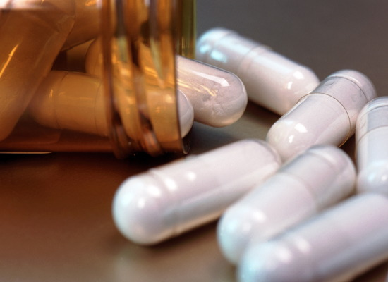
A short history of
Chinese (~2500 years ago) realise that a mould on soy bean curd prevented infections occurring when applied to wounds
Alexander Fleming (1928) notices that a strain of Penicillium mould growing (by accident) on his agar gel inhibits growth of bacteria (what he was really studying). He isolated the chemical compound from the mould that was killing the bacteria – ‘Penicillin’
Howard Florey (1940) develops a new strain of Penicillium with high yield, industrialising Penicillin production – the birth of the biotechnology industry, and the start of widely available antibiotics.
Nowadays microorganisms used in the biotechnology industry are genetically engineered to synthesize the desired compounds as products of fermentation.

